Slide 1
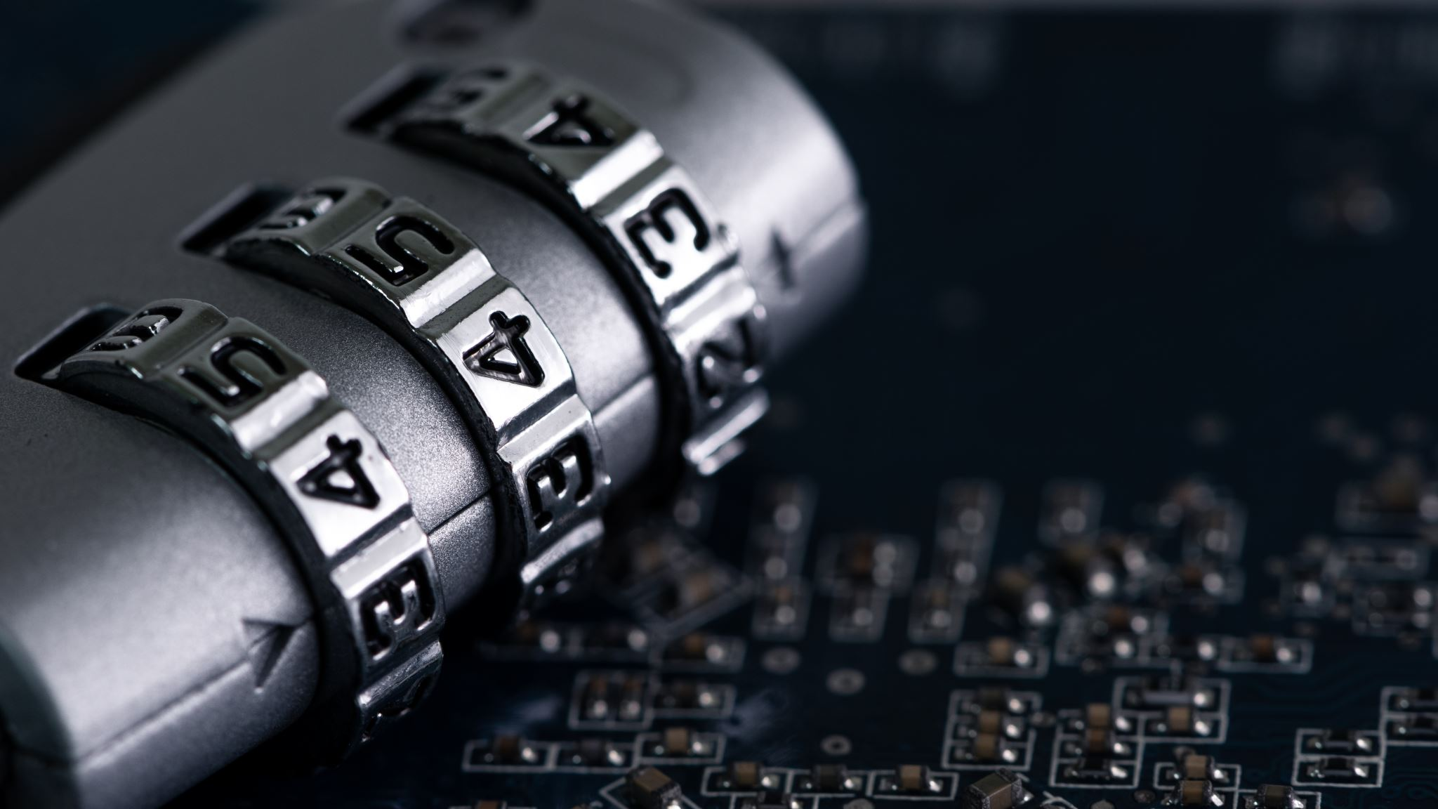
Cracking the Code! Keeping Secrets Safe
By: Marcus Jackson
CTEC 445-101
Date: 2/23/25

Slide 2

What is Cryptography?
Cryptography is the process of generating secret codes to protect messages from prying eyes. It is how we safeguard our data when we transfer it across the internet.

Slide 3

Symmetric Encryption: One Key
Symmetric Encryption Overview
• Locks and unlocks messages using same key.
• Similar to standard lock and key.
• Both sender and recipient require same key.
Ex. Imagine you and your friend have a special code word. You use it to write secret notes to each other.

Slide 4
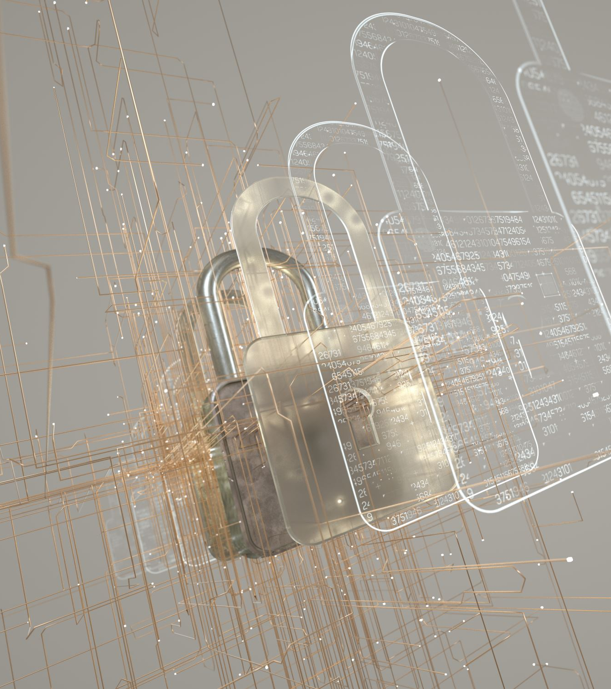
Asymmetric Encryption: Two Keys
Two Keys: Public and Private!
• Uses public and private keys.
• Public key: Unlocked padlock.
• Private key: Only key opens specific padlock.
Ex. Imagine you put your message in a special box and lock it with your friend's public padlock. Only your friend has the private key to open it.

Slide 5
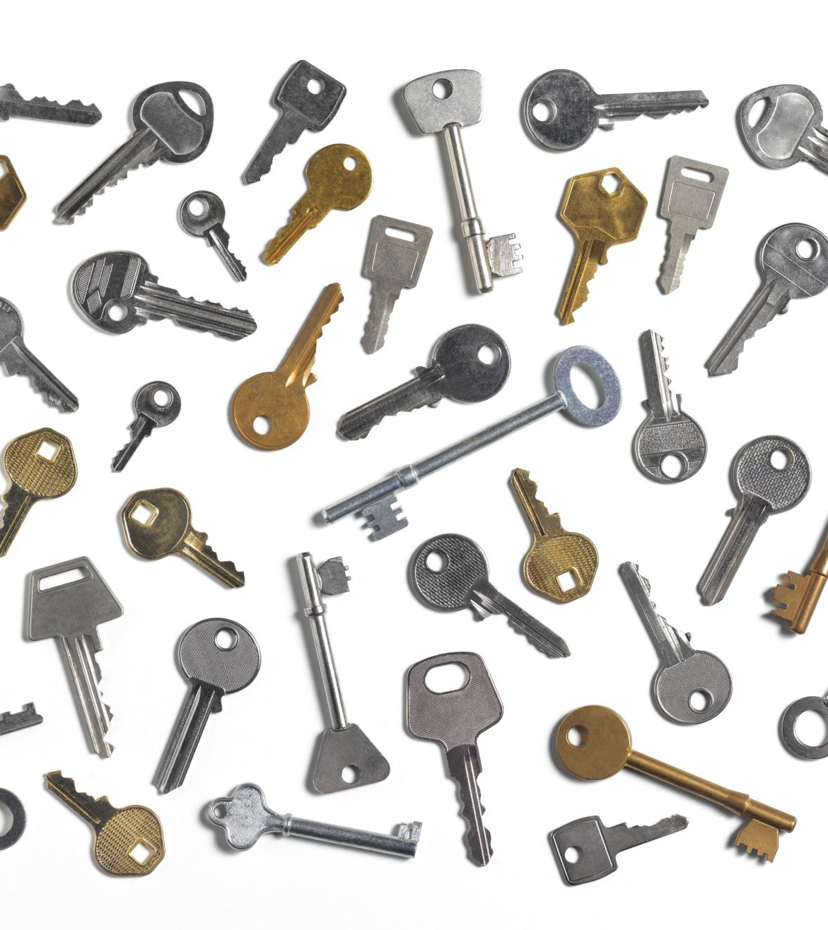
Key Exchange: Sharing the Secret
Safe sharing of secret keys, especially for symmetric encryption.
Similar to passing notes in class.
Utilizes special math tricks online.

Slide 6

Digital Signatures: It's Really Me!
Functions similarly to a stamp to verify message authenticity.
Uses math for secure signing.

Slide 7

TLS: Keeping the Internet Safe
TLS: Internet Connection Bodyguard.
Uses encryption for data protection.
Secures online transactions and email conversations.
Identified as "S" in HTTPS.

Slide 8

Case Study: The Big Oops!
Target, a large store, has an issue. Hackers discovered a technique to break into their computer systems and steal information such as credit card numbers and names. It seemed as if someone broke into the store's office and grabbed all of the customer files! This occurred because the store's computers were not adequately safeguarded, much like a door with a very weak lock.

Slide 9

Fixing the Oops! (Target Case)
To prevent the hackers from obtaining information again, Target might have utilized even stronger secret codes and passwords to secure all of the vital facts. It's like obtaining a super-strong lock for your office door, and only the proper individuals have the key. If everything is encrypted, the evil guys will be unable to read anything!

Slide 10
References
https://www.nist.gov/cyberframework
https://www.cloudflare.com/learning/ssl/what-is-a-cryptographic-key/
https://www.cloudflare.com/learning/ssl/transport-layer-security-tls/
https://redriver.com/security/target-data-breach#:~:text=What%20Happened%20During%20the%20Target,was%20one%20of%20the%20largest.

